Slide 1


COMPARATIVE STUDY OF SOIL
Navya shree.R 11th , Chinmay Desai 9th , Megna Mahesh 8th

Slide 2
Introduction
Bengaluru has evolved from pensioners paradise to silicon city.
Bengaluru is one of the largest cities of India known for IT companies, factories. It also enhances economic development of our country.
Garden city of India is in verge to be garbage city due to various factors of urbanization.
We are trying to find a path to make this metropolitan city into a green city again by exploring the soil which is better for ecosystem.

Slide 3
Objectives
To do a comparative study of different types of soil which we have collected from different locations in Munnekolallu.
To find the components in soil which promotes biodiversity.

Slide 4
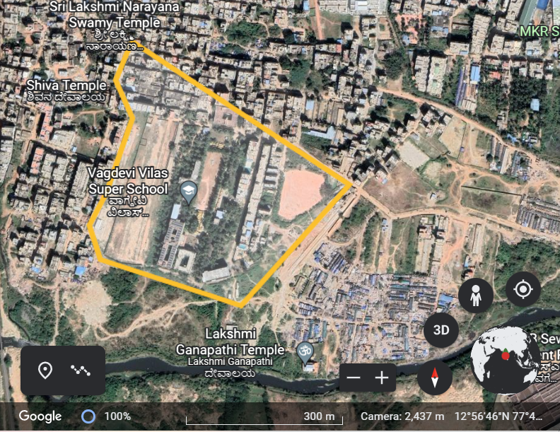
Study area

Slide 5
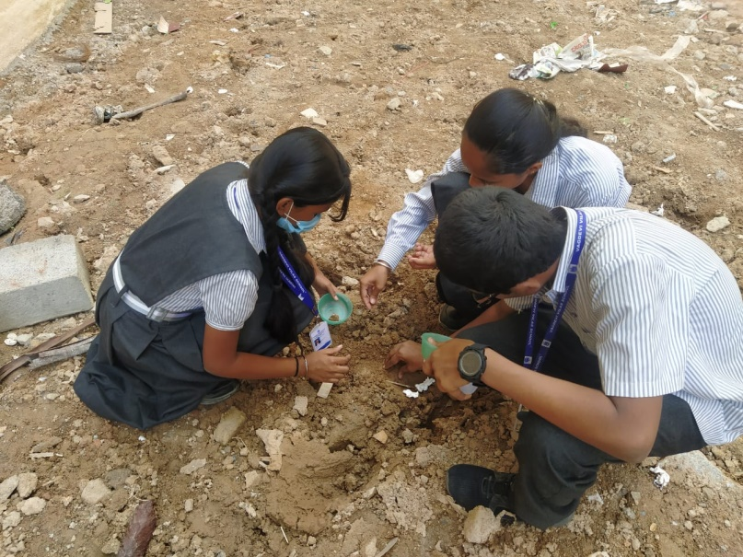
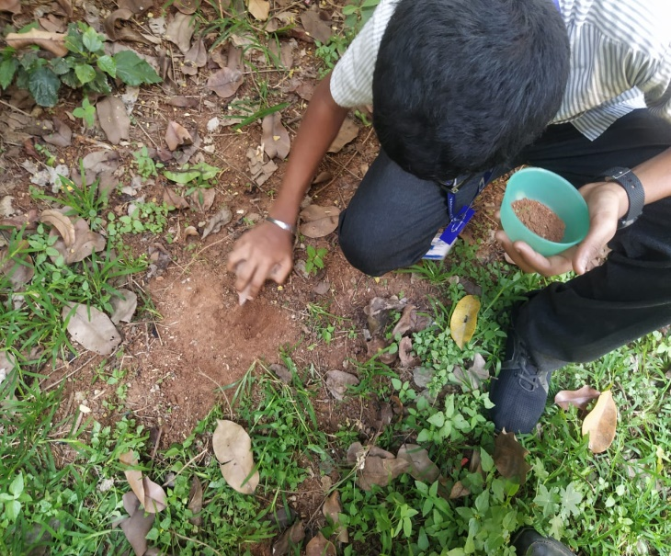
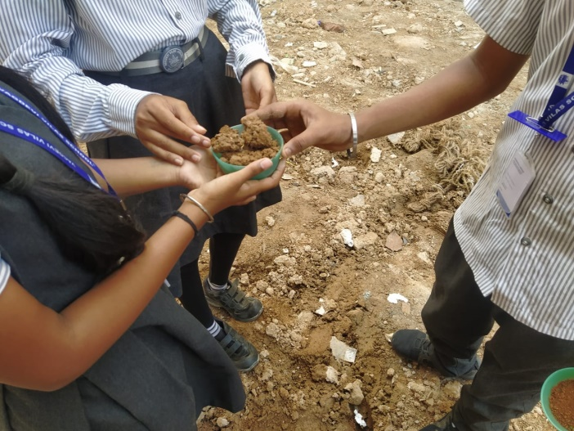
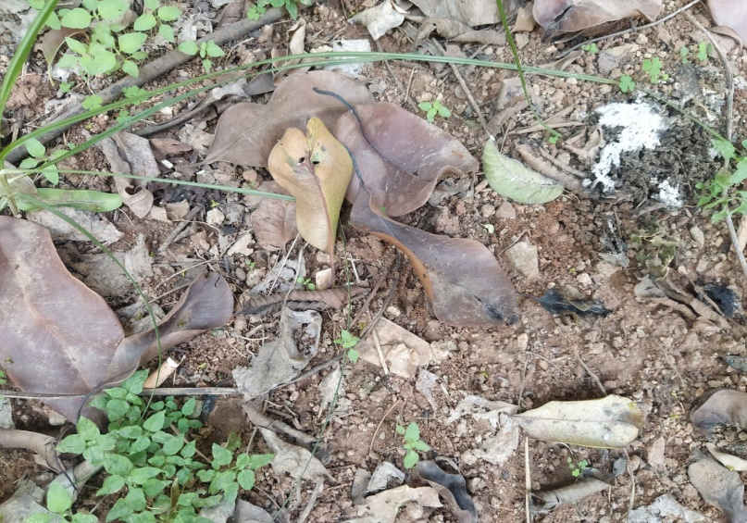
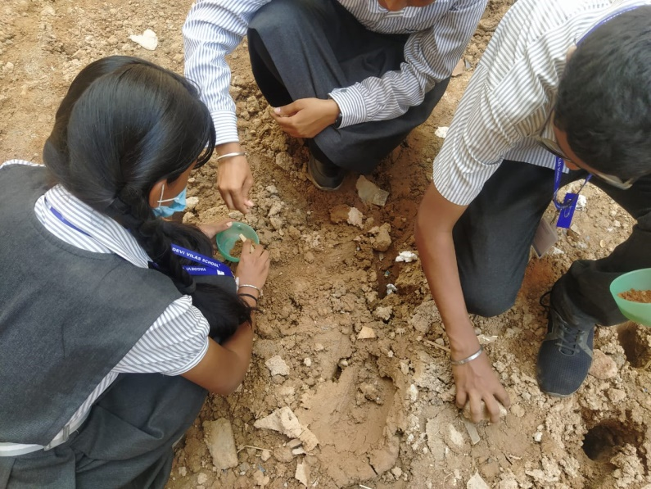
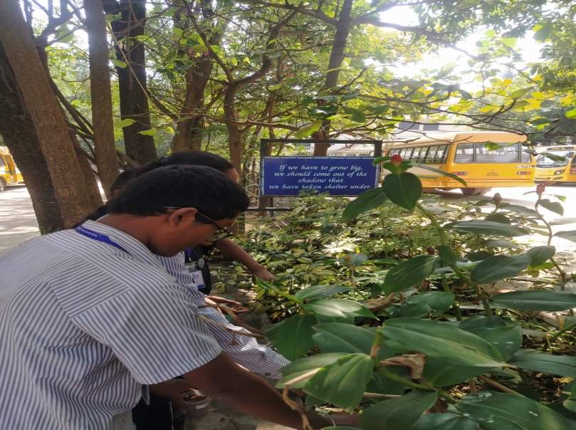
Materials and Methods
Sample collection method

Slide 6
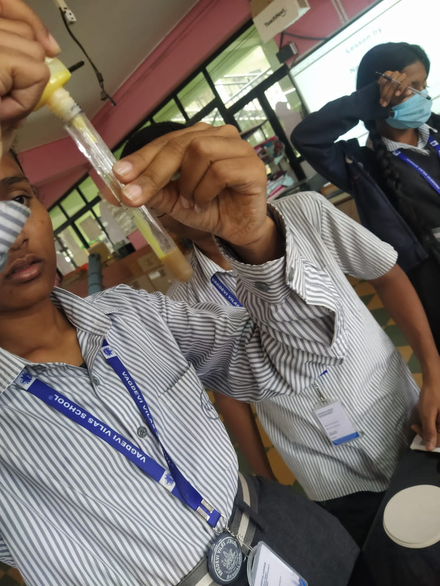
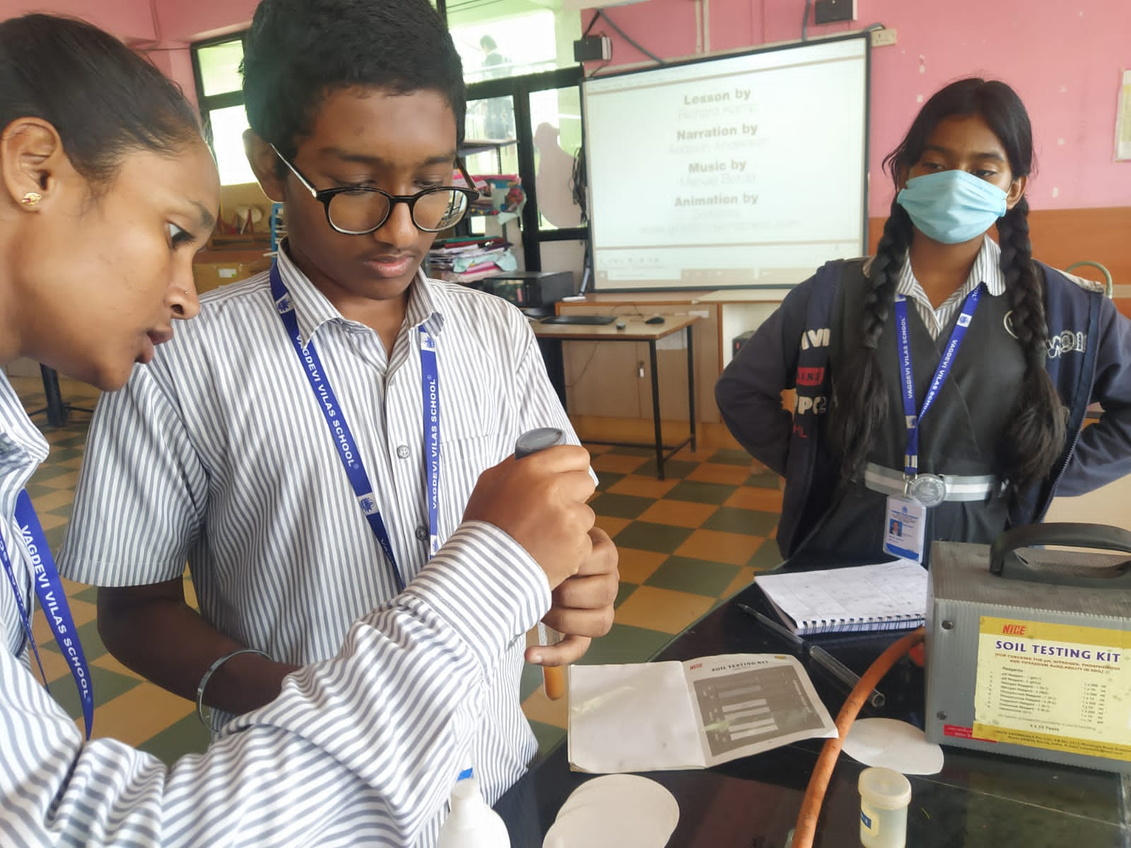
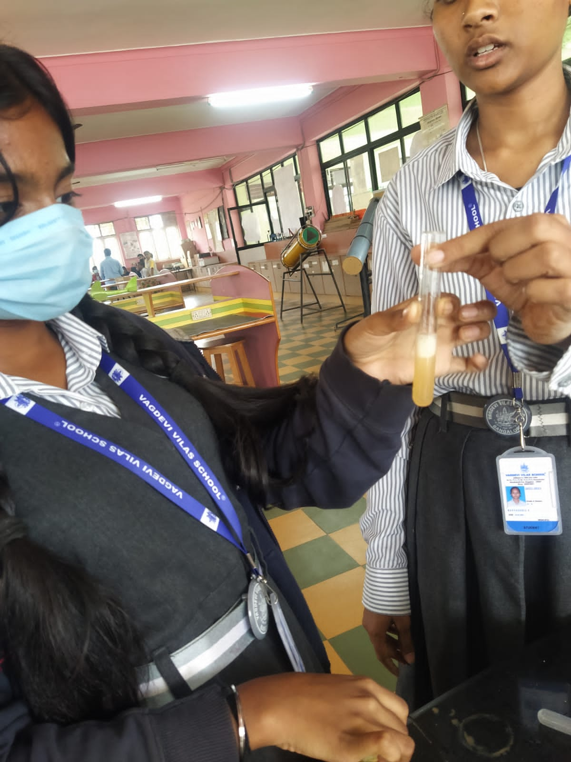
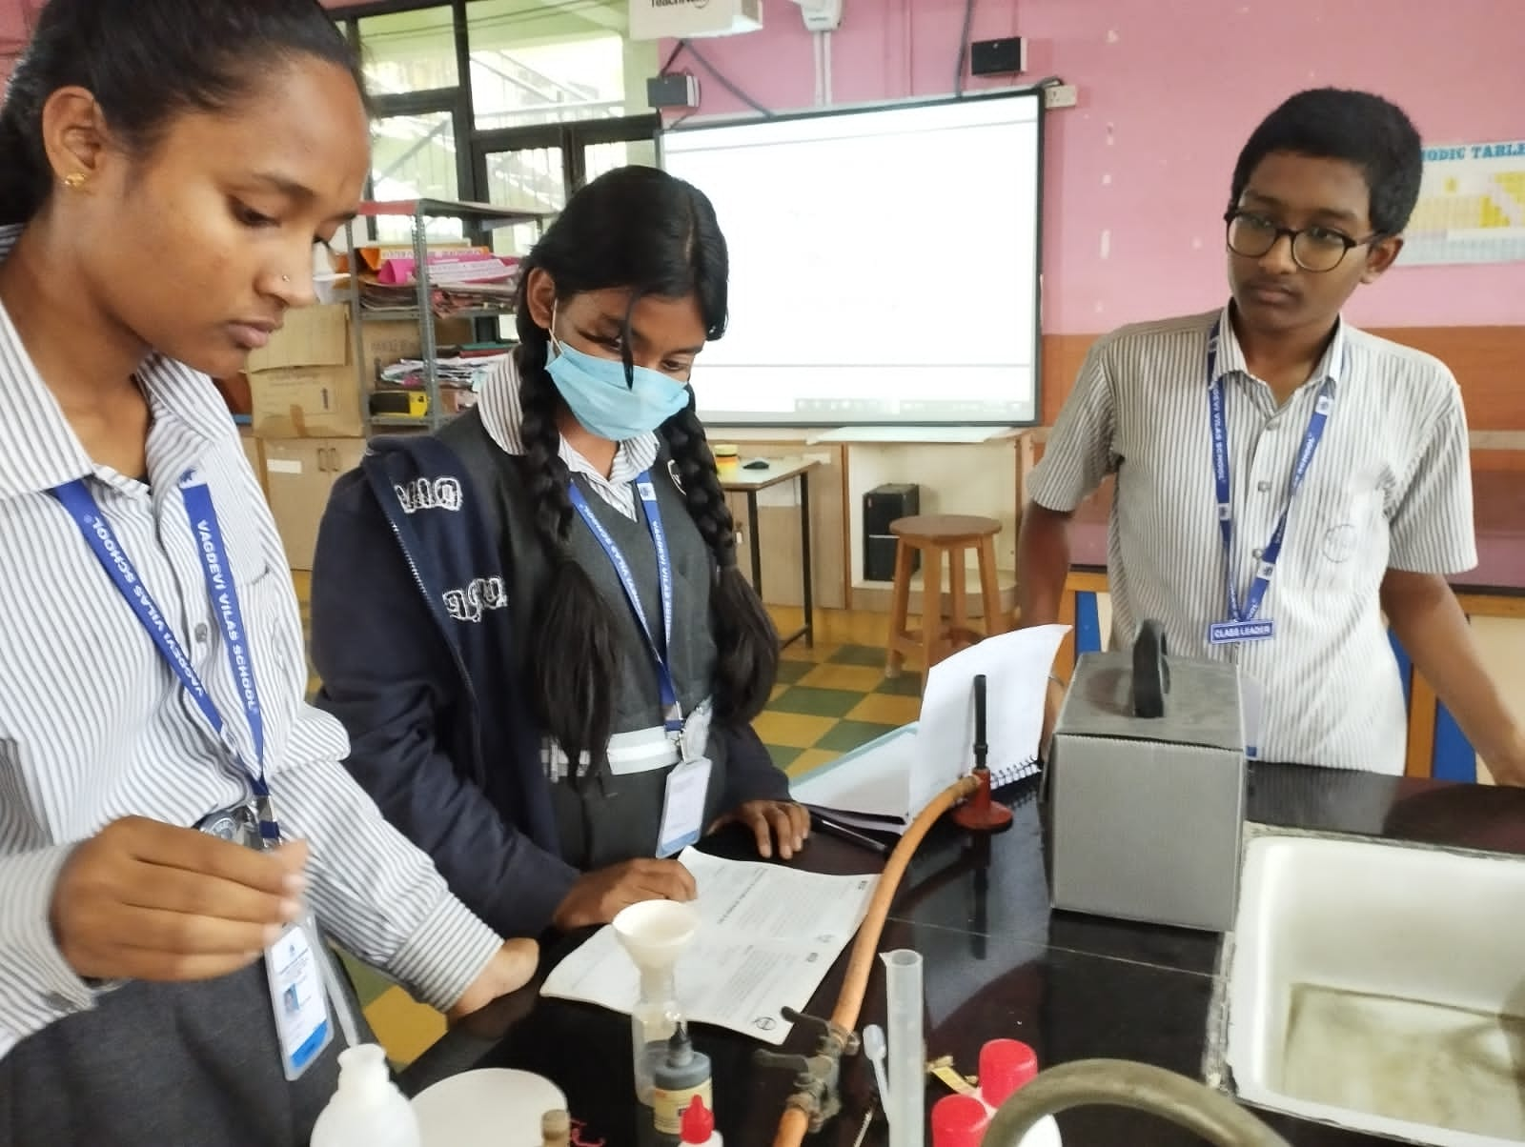
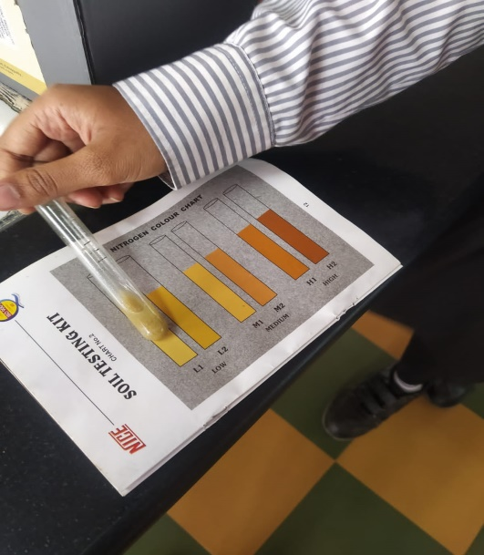
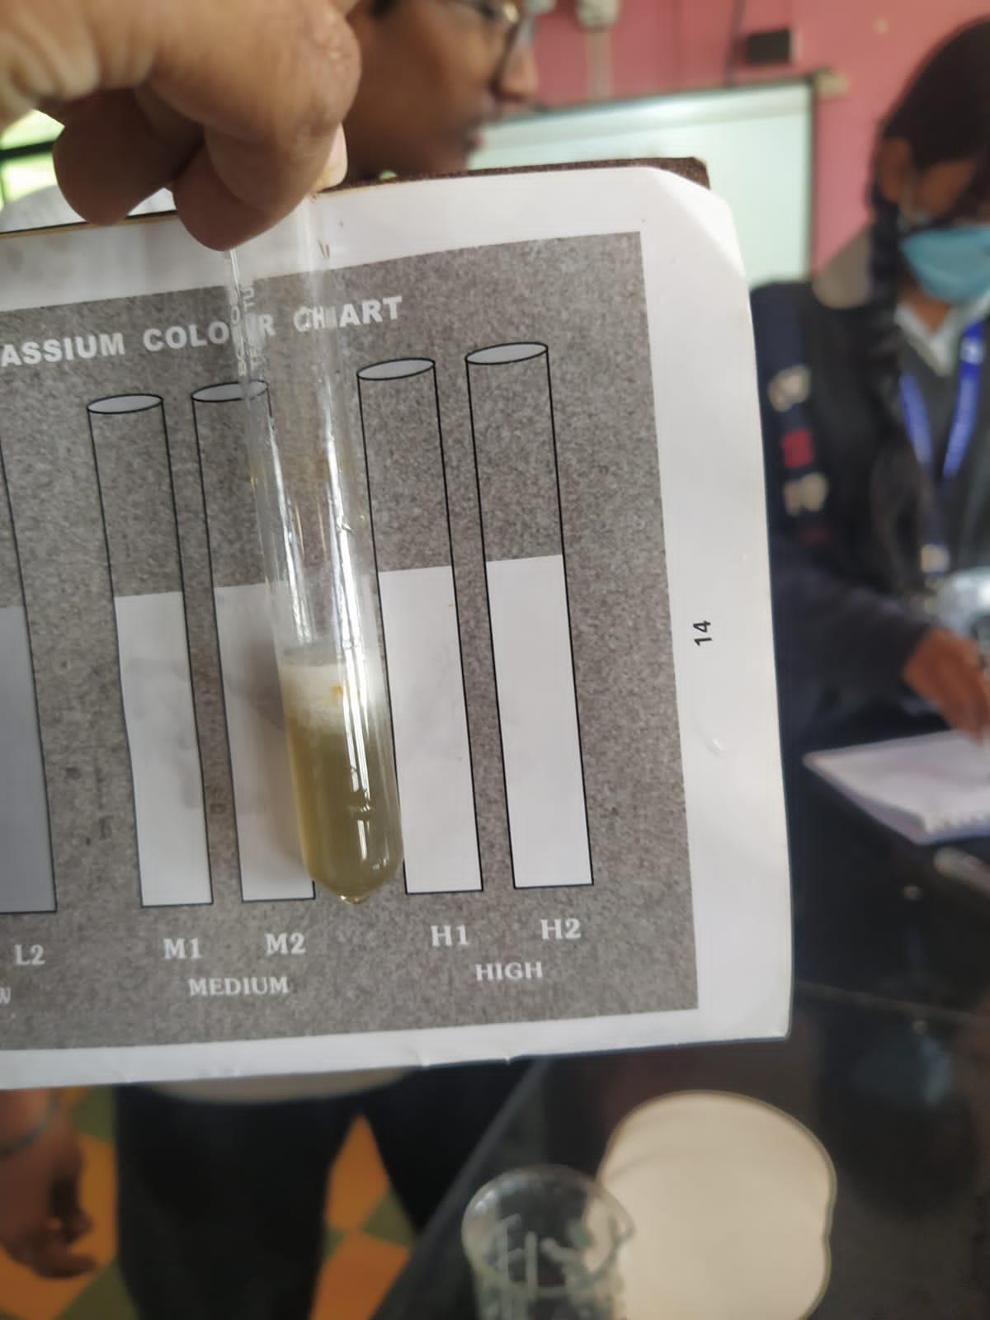
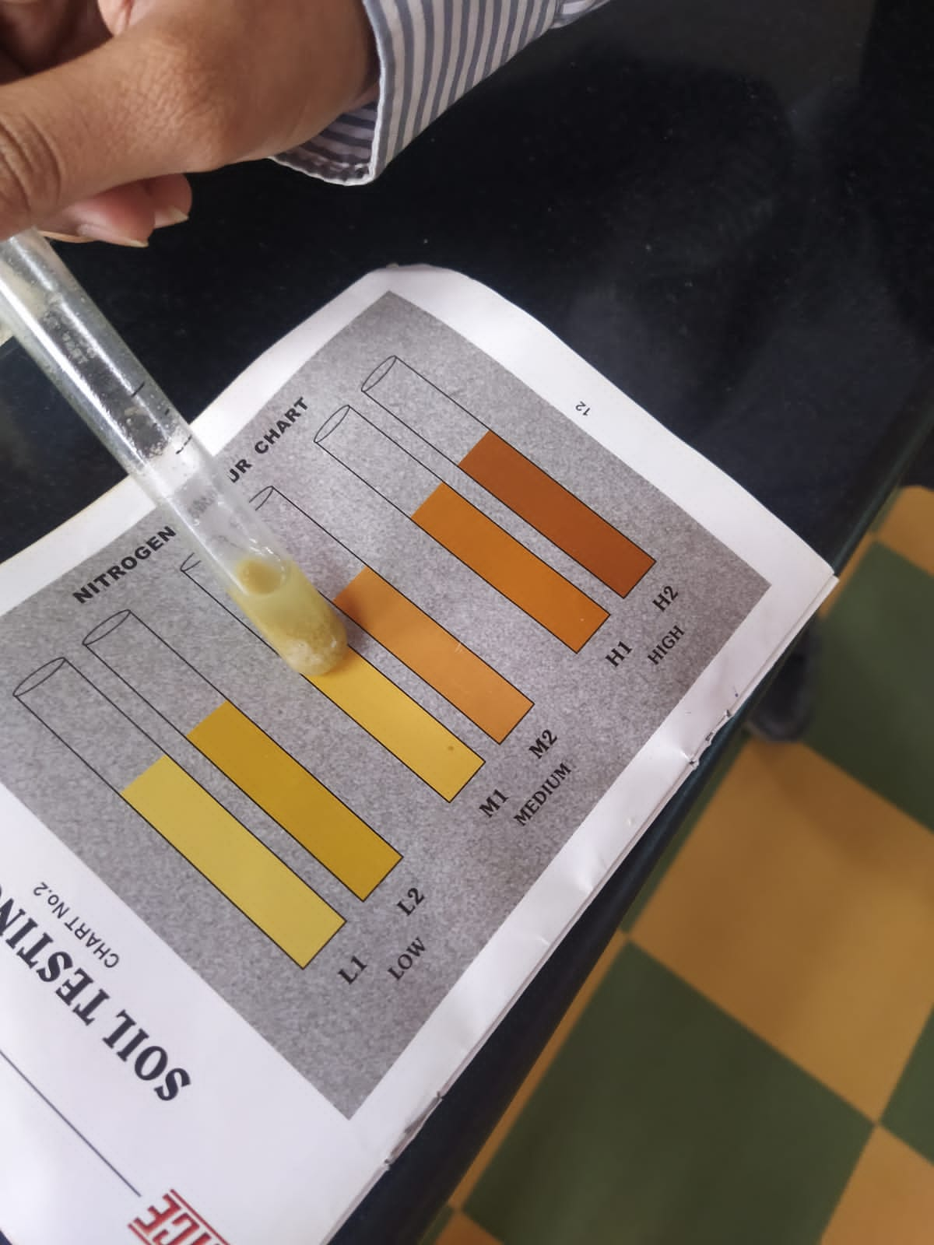
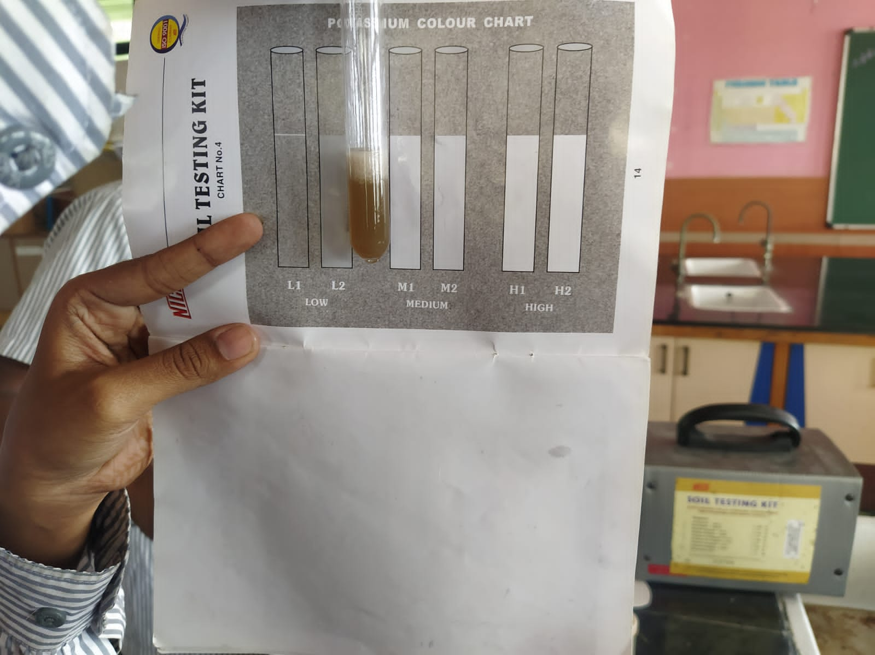
Soil sample test

Slide 7
Results and Discussion
Tables and Figures
Soils | Ph. test | Nitrogen | Phosphorus | Potassium
Soil 1 | 8.5 | L2 | L2 | H1
Soil 2 | 7.5 | M1 | M2 | M1
Soils 3 | 8 | L2 | H1 | L2
Construction site soil | 8 | M2 | M1 | M1
construction site soil 2 | 7 | M1 | M1 | M2
LEVEL | N | P | K
L1 | <50kg/acre | <1kg/acre | <25kg/acre
L2 | 50-99kg/acre | 1-3kg/acre | 25-49kg/acre
M1 | 100-150kg/acre | 4-7kg/acre | 50-80kg/acre
M2 | 151-200kg/acre | 8-10kg/acre | 81-120kg/acre
H1 | 201-300kg/acre | 11-15kg/acre kg/acre | 121-150kg/acre
H2 | >300kg/acre | >15kg/acre | >150kg/acre

Slide 8
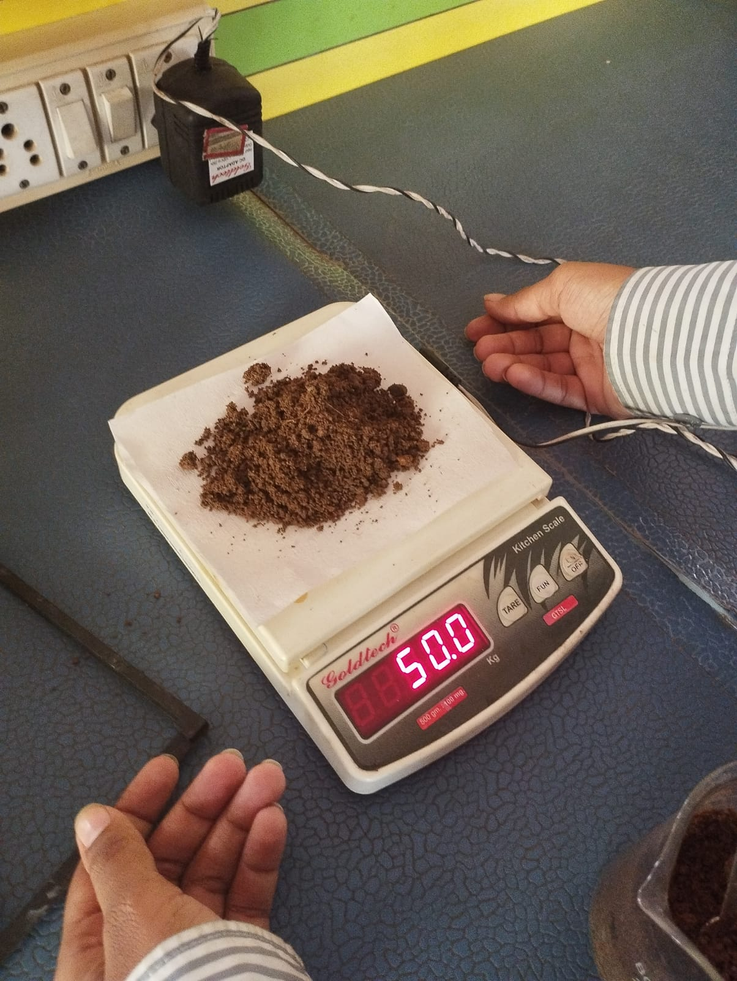
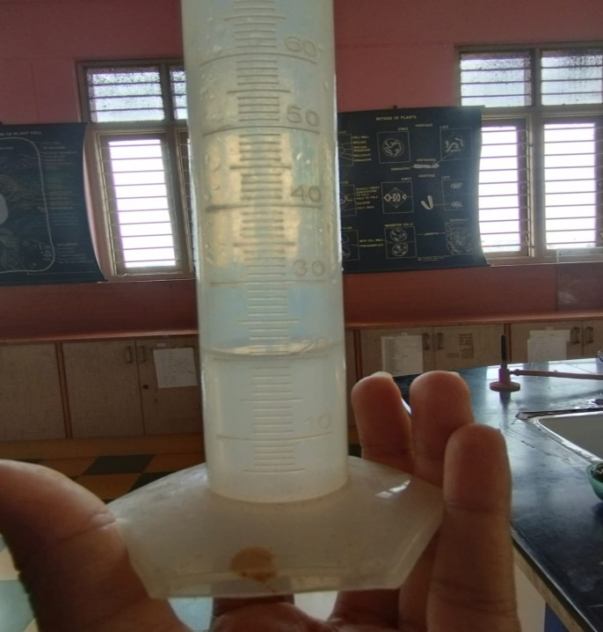
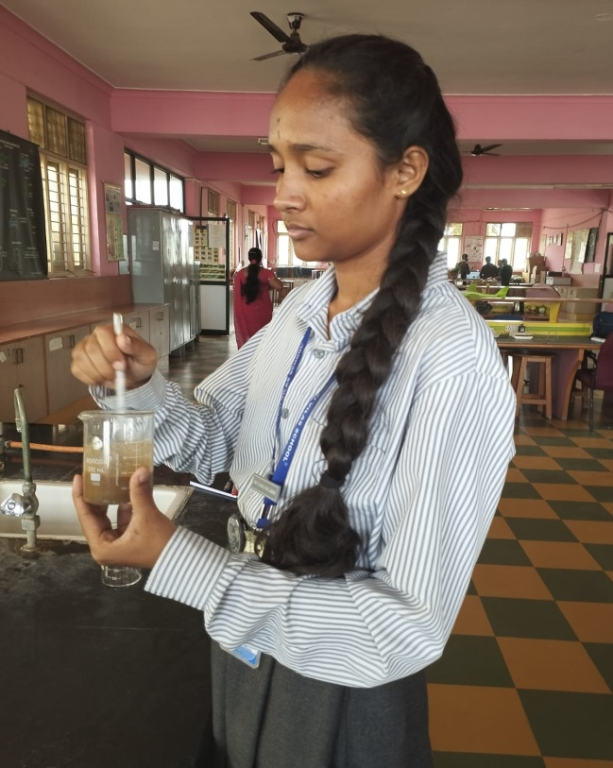
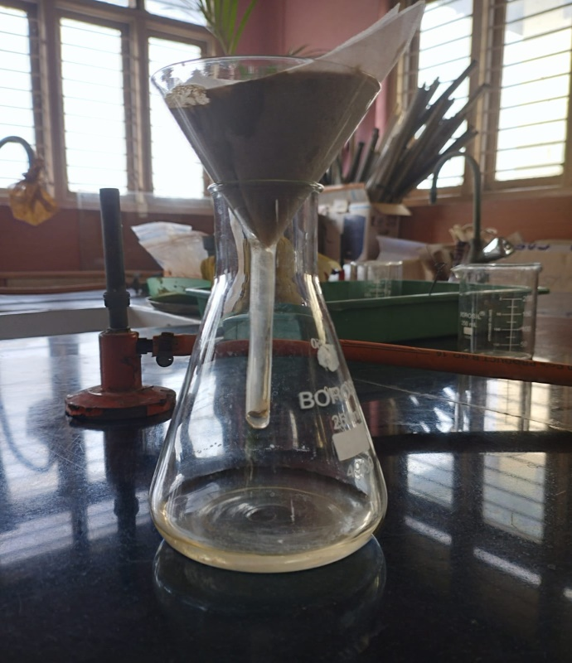
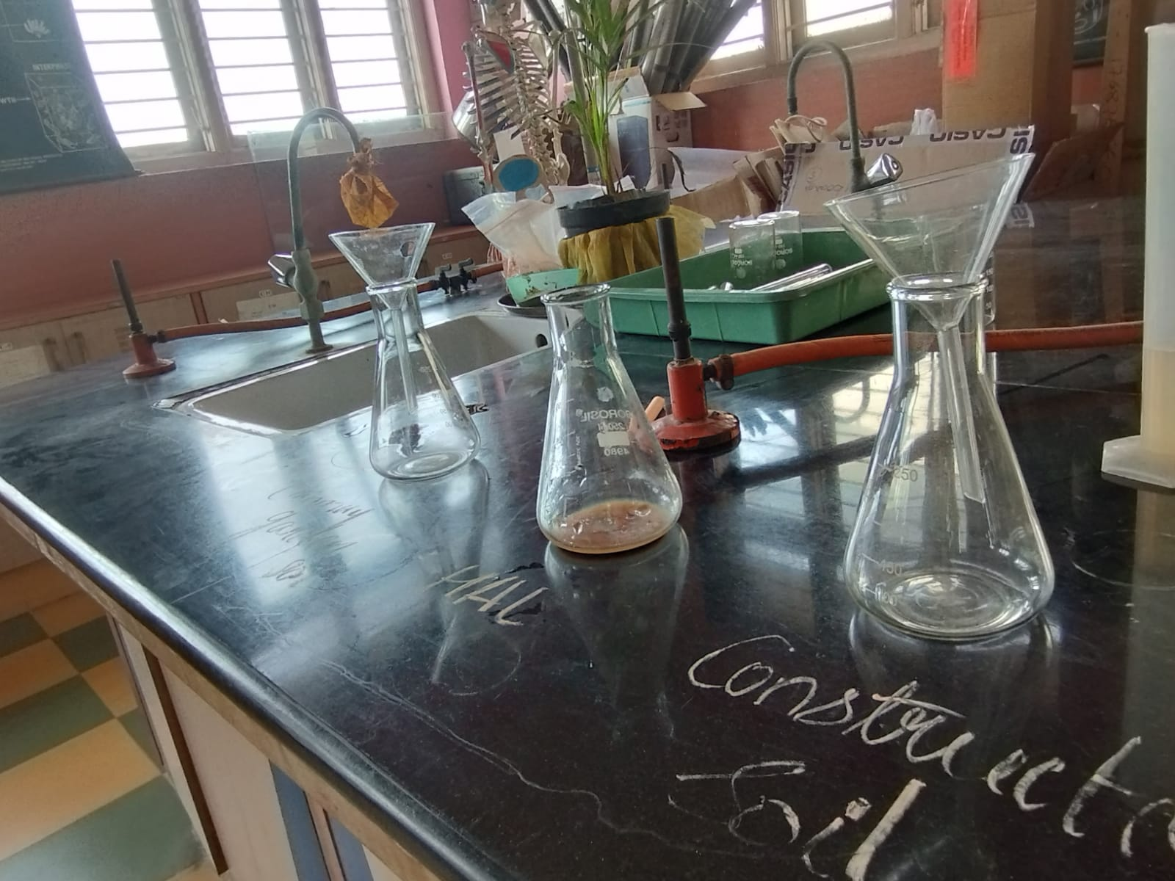
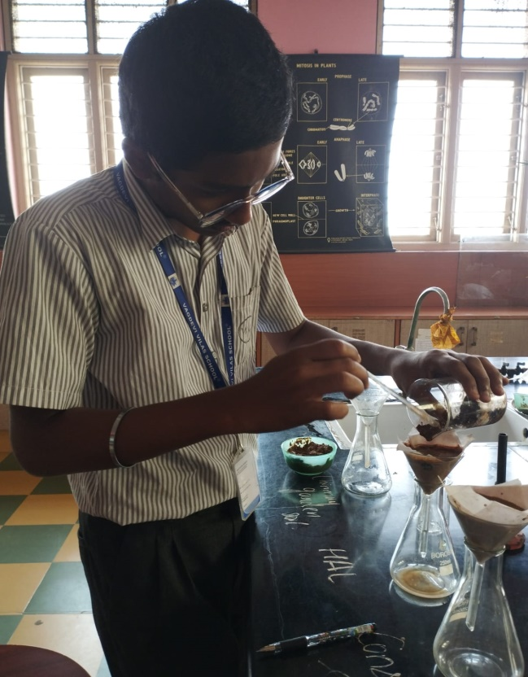

Slide 9
Percolation test
Percolation rate =amount of water(ml)
percolation time(min)
Soil | Time taken | Total amount of water percolated
Soil 1 | 25 mins | 33 ml
Soil 2 | 28 mins | 23 ml
Constructions soil | 14 mins | 35 ml
Soil 3 | 25 mins | 25 ml
Percolation rate
2
1.7
3.5
2

Slide 10
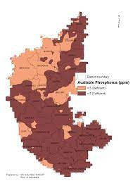
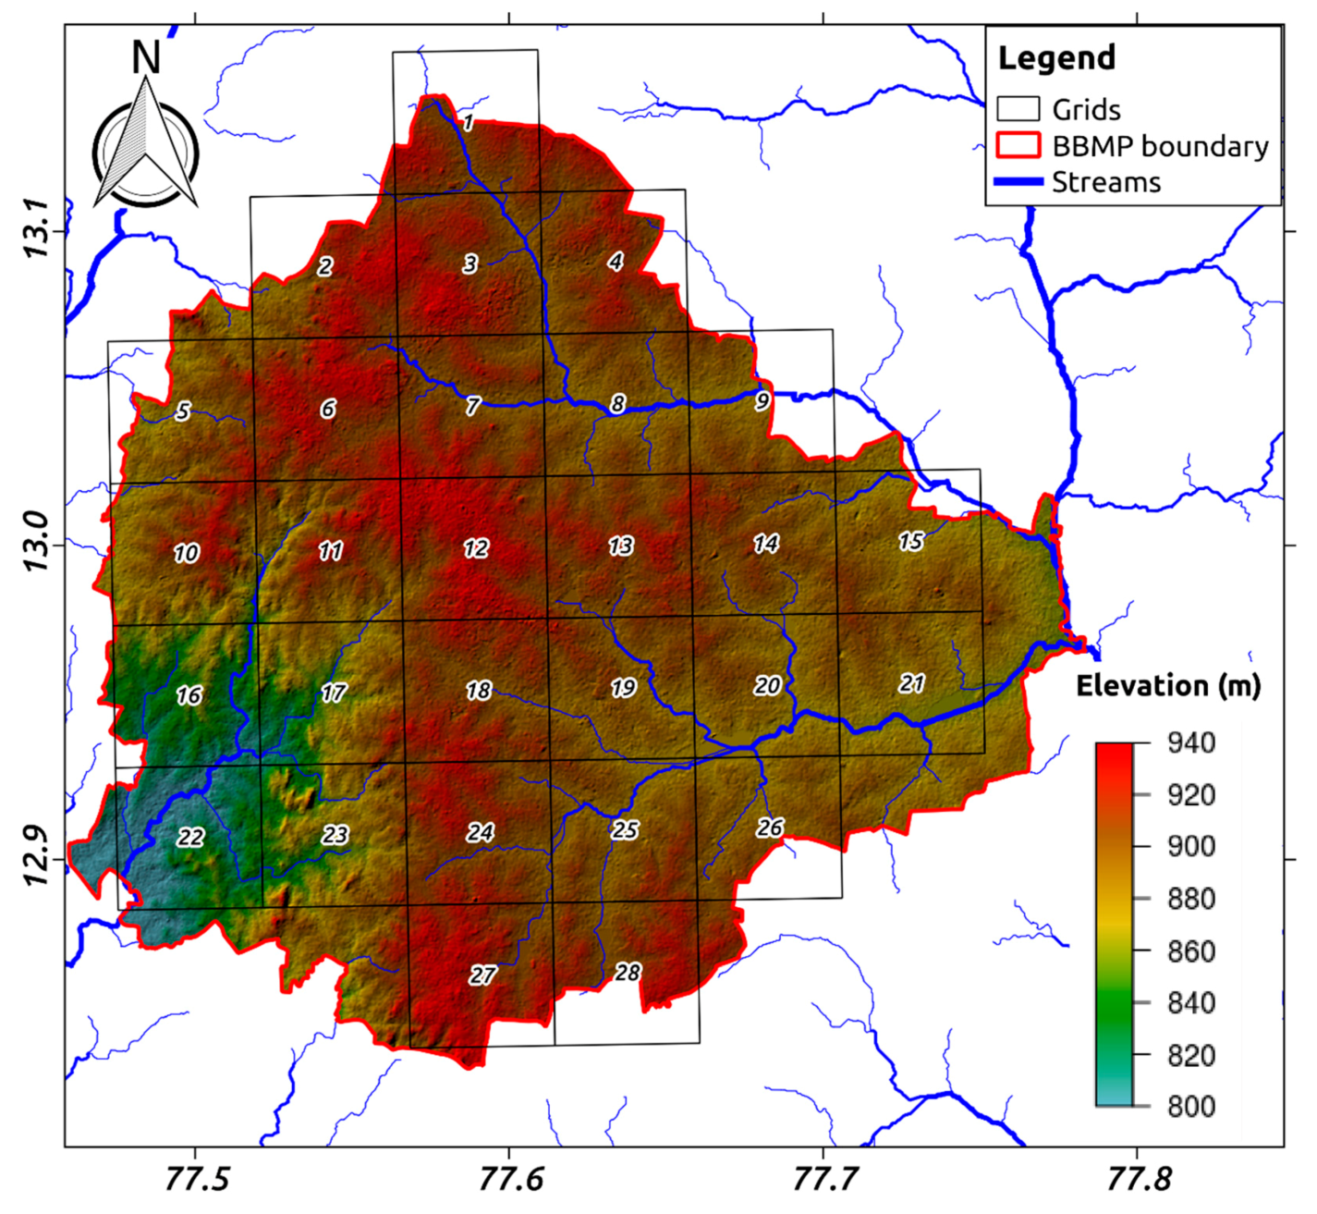
GSI images
Underground water
Soil

Slide 11
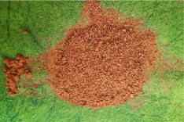
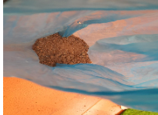
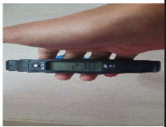
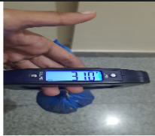
Moisture content
Moisture content in soil compared between sunny and rainy days.
And we have observed the water moisture content in the soil samples

Slide 12
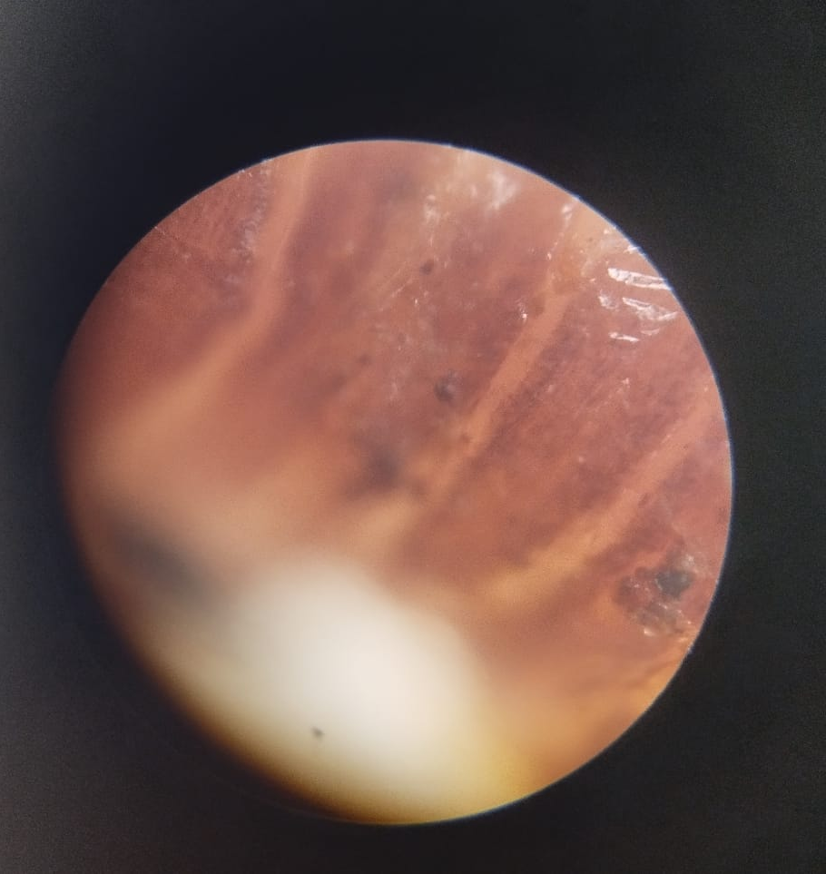
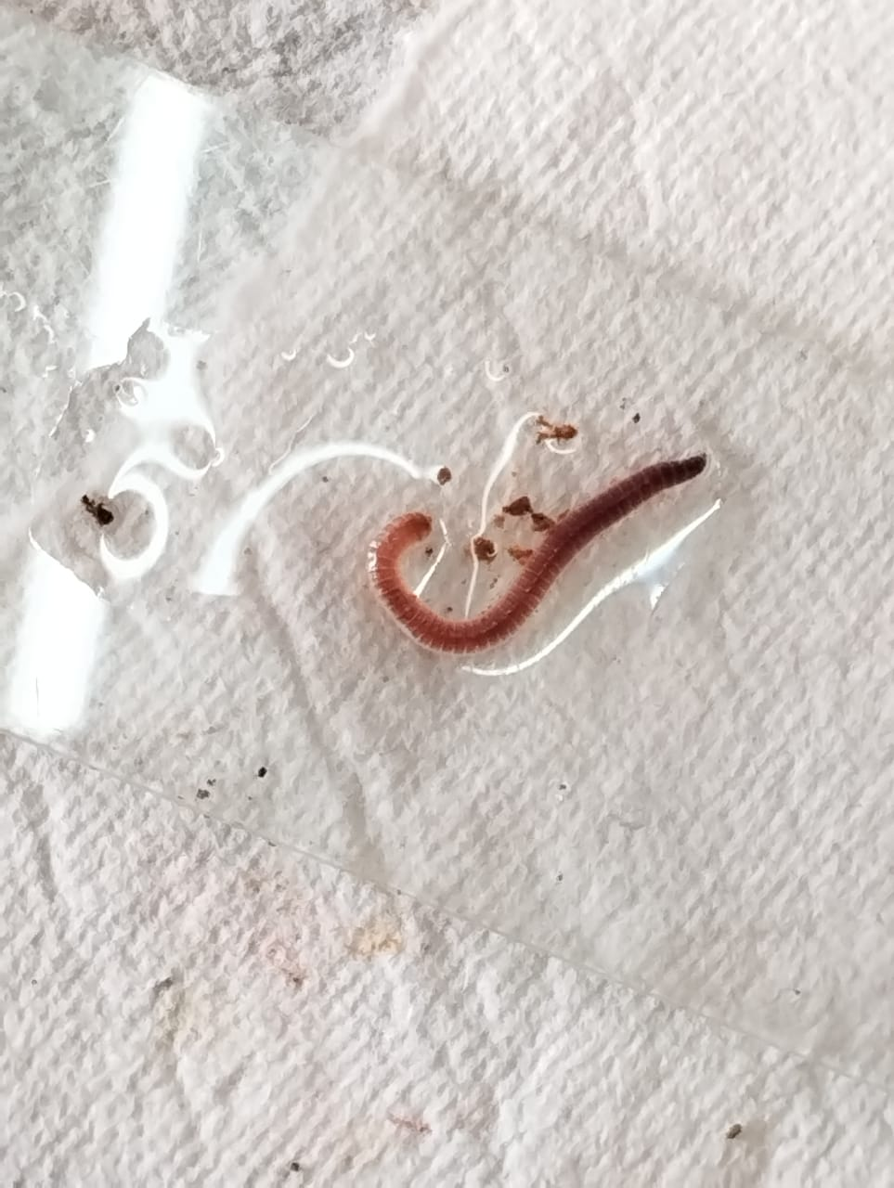
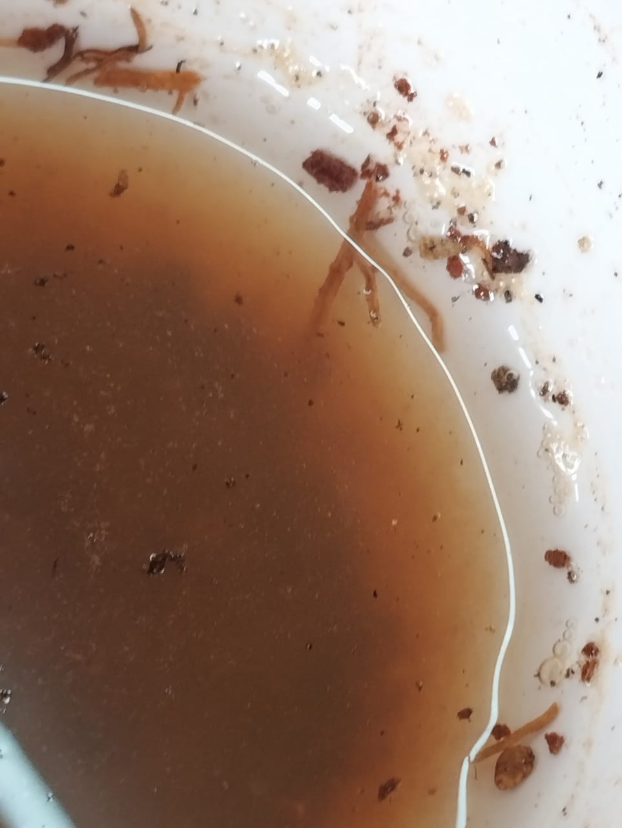
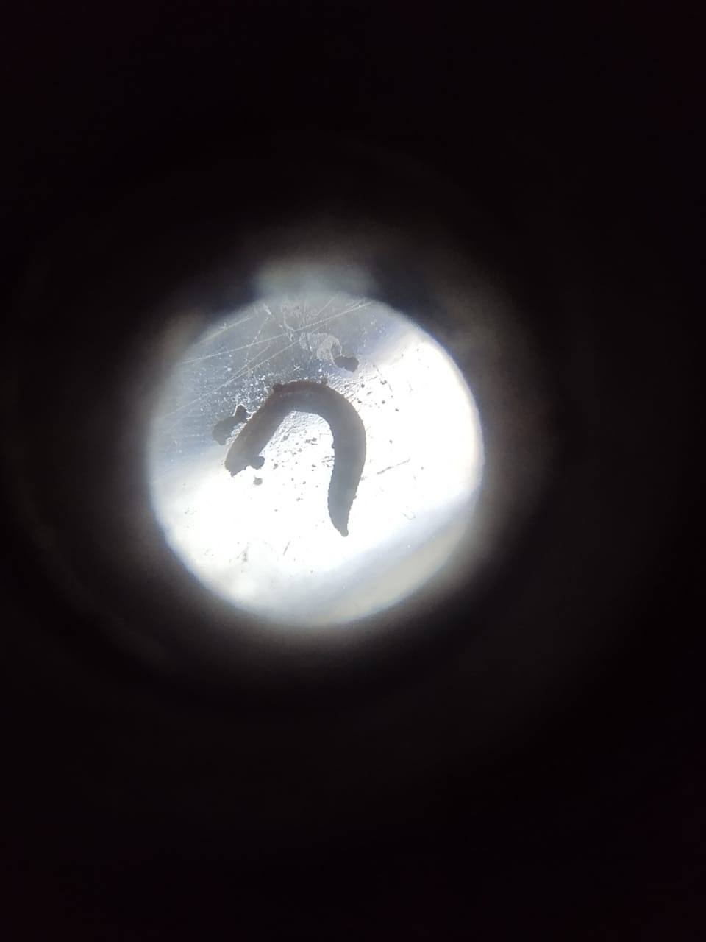
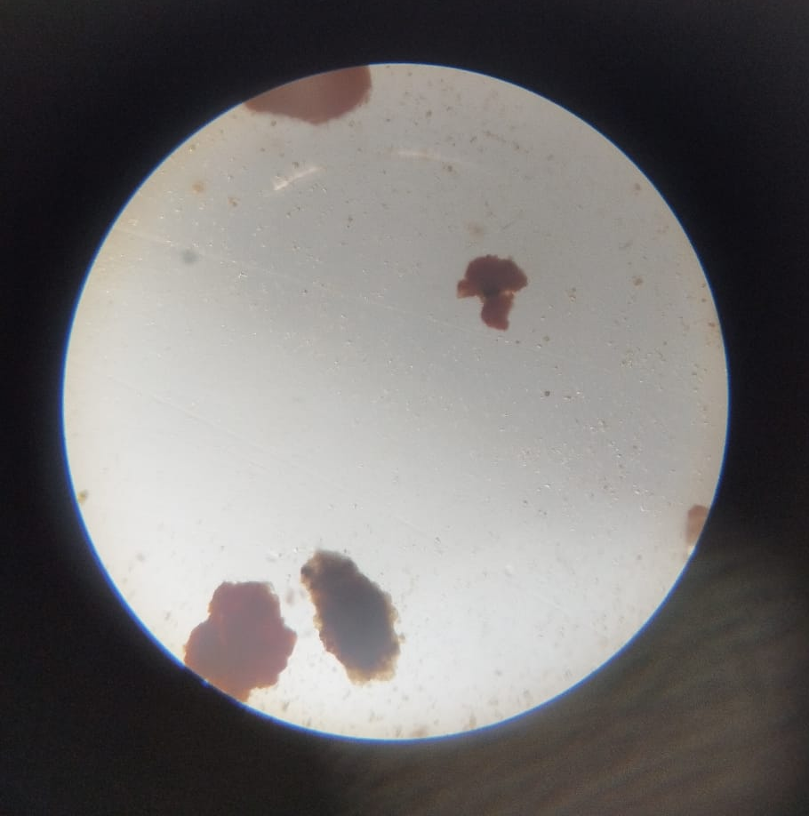
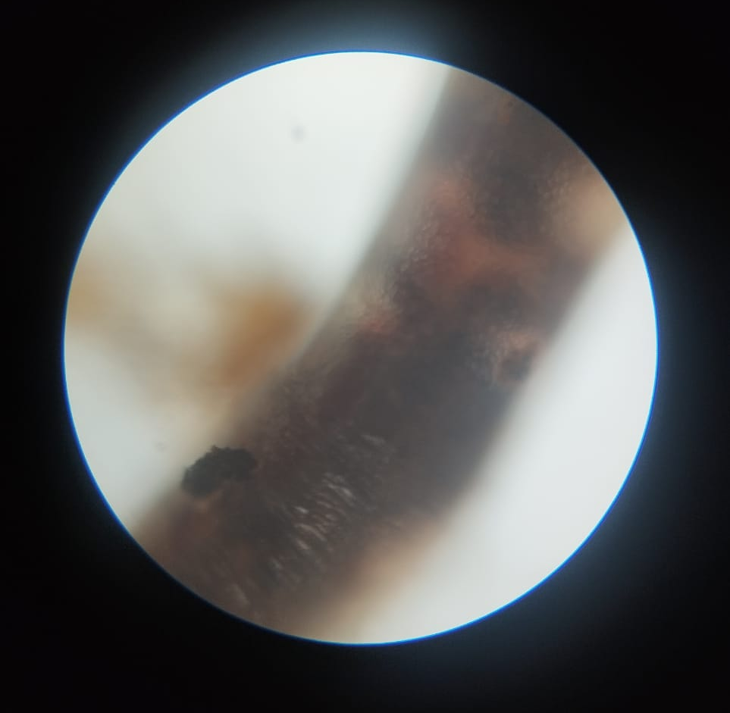
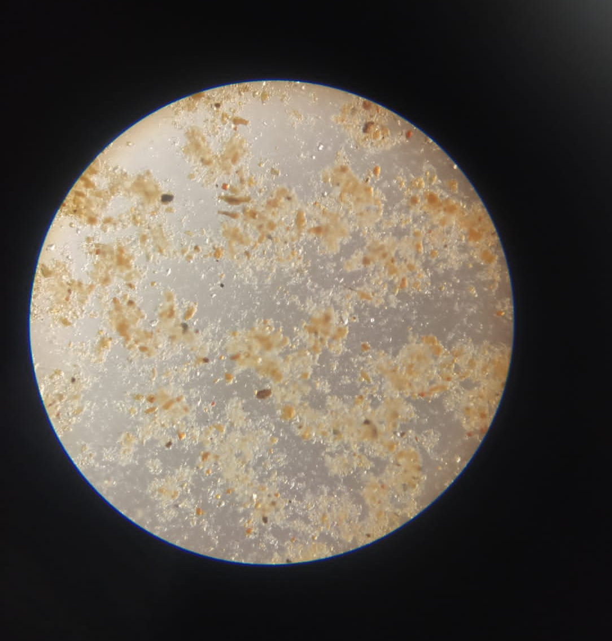
Living and dead organisms in the soil samples

Slide 13
Problems being faced
Due to rapid urbanization the concrete jungle has made the soil suffer from toxic elements and degradations.
We also need microorganisms for complete decaying of matter and making the soil fertile and keeping it nutritious.
Due to the recent floods the top soil was been eroded and polluted by the plastics and toxic things mixed along with overflowed water.
Microorganism which are required for the decomposition ,of decaying matter is absent in the soils of construction and roadside soils.
It makes the soil less fertile.

Slide 14
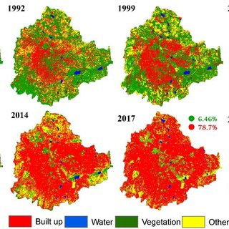
GSI images of Bengaluru then v/s now

Slide 15
Solutions
However we found lots of farmers friends, i.e. earthworms nearby the compost areas in our school. That indicates, if we have taken enough measures the barren places would be having more greenery as well as diverse environment.
Growing different types of plants to stop the soil erosion.
Adapt the tilling practices.
Produce home made compost
Segregation of waste, proper waste management can decrease the degradation of soil.
Support the nearby people or projects who have taken up the initiative to save our ecosystem.

Slide 16
Conclusion
Soil analysis is very important in order to determine the components of soil for sustainable diverse ecosystem.
Soil erosion is the main problem being faced.
Planting plants can reduce the erosion
Organic matter or compost is usually the most effective treatment.

Slide 17
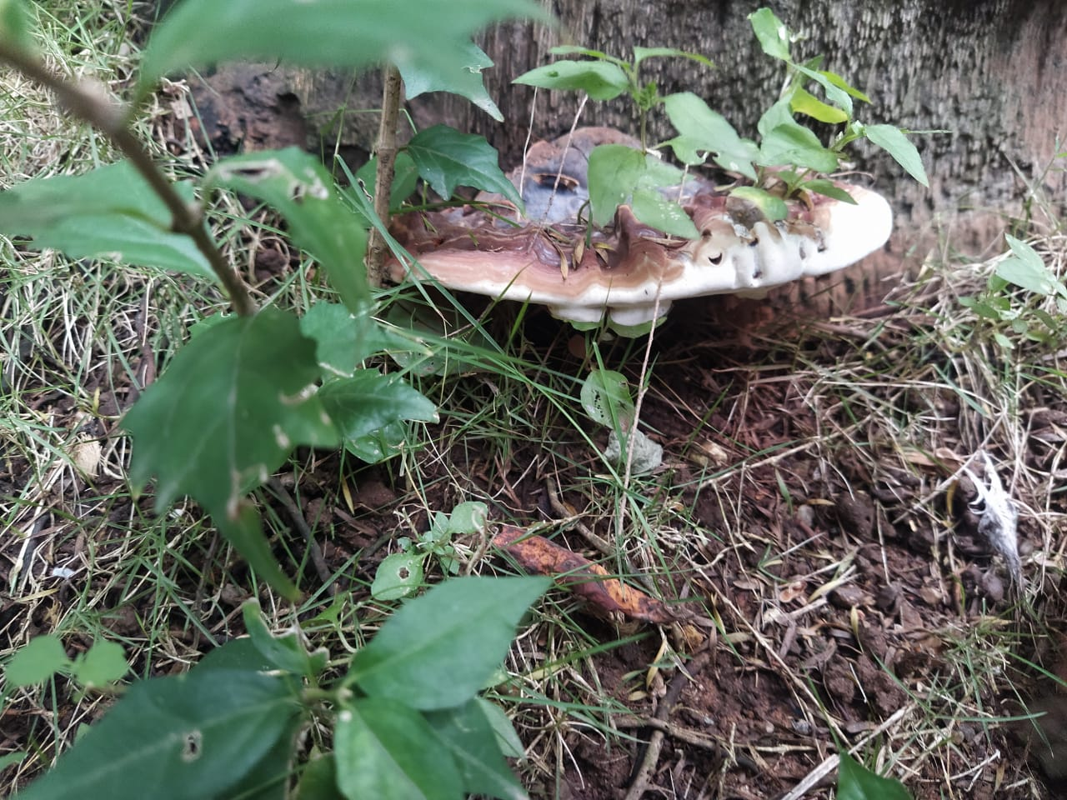
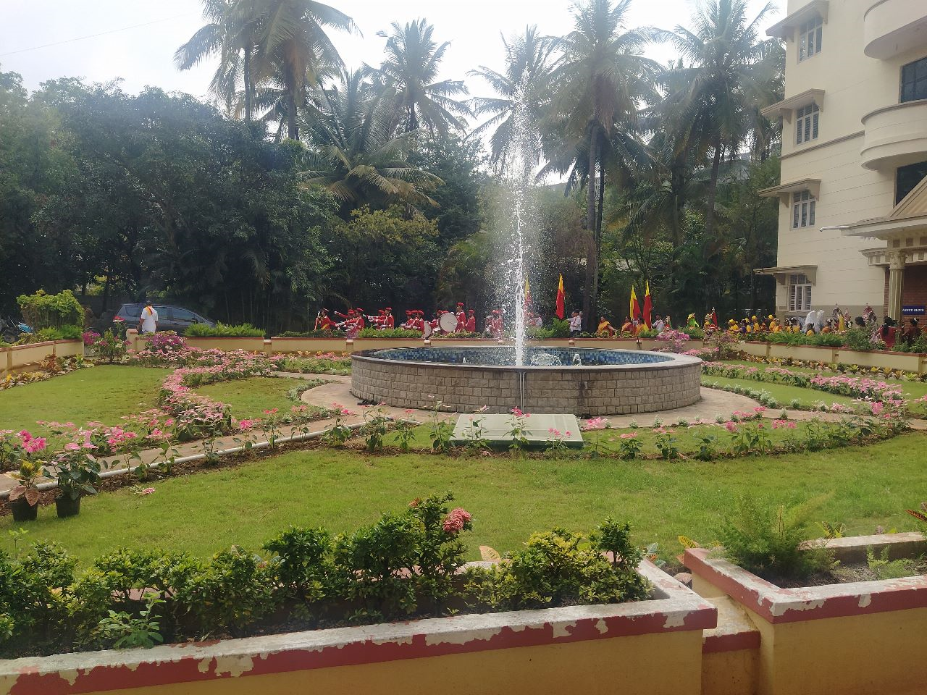
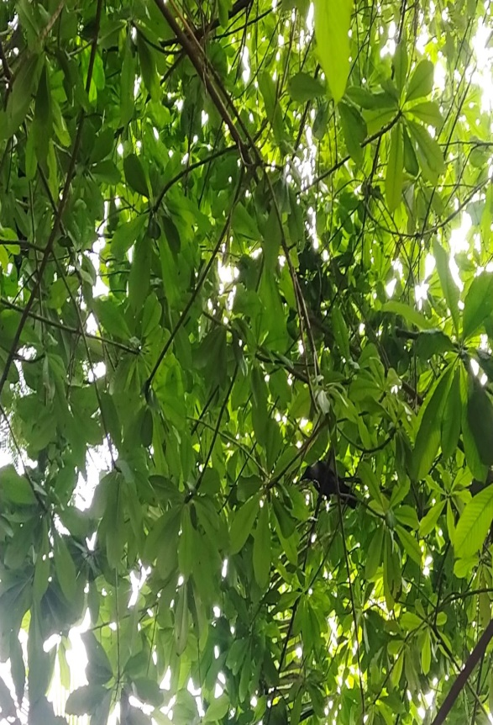
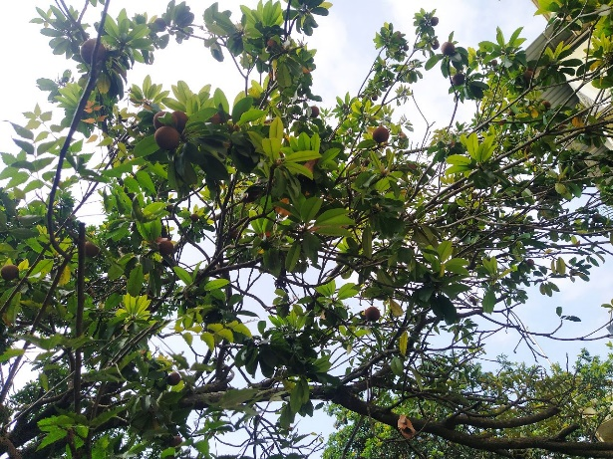
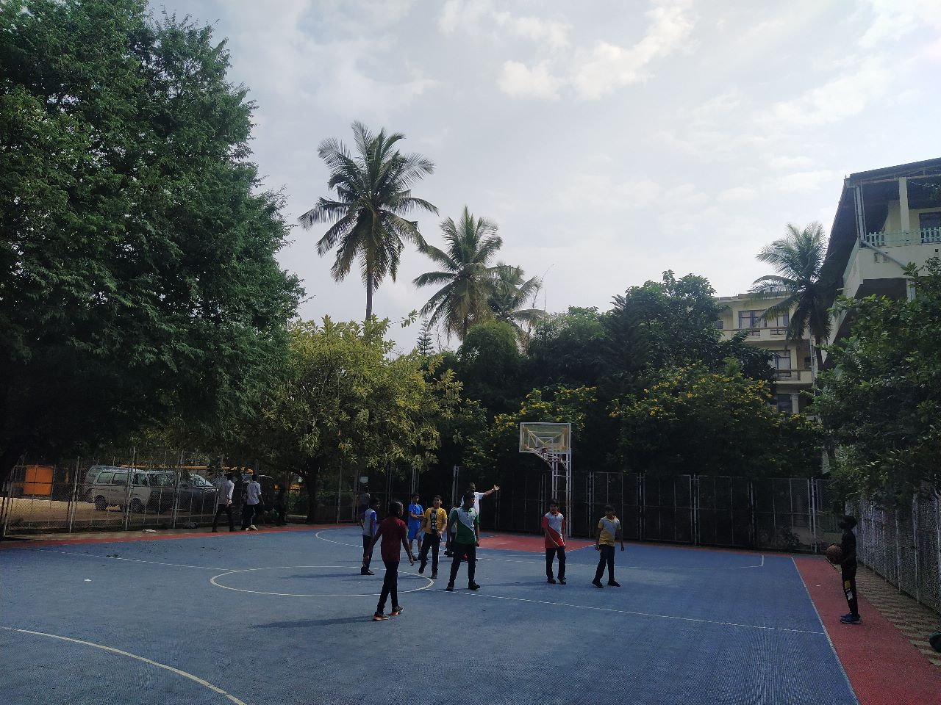
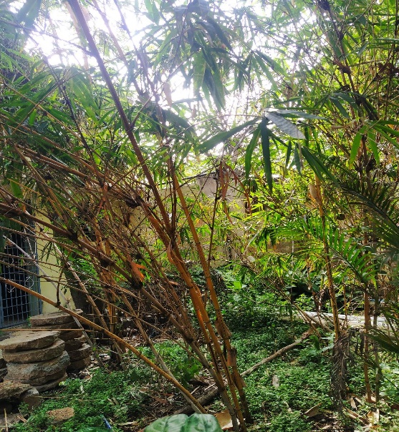
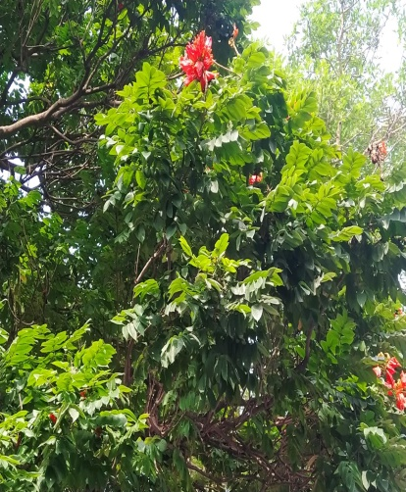
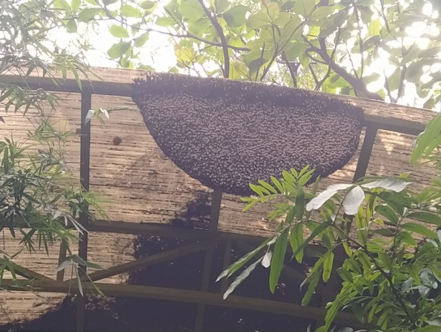
Macrolepiota albuminosa (termite mushroom) Fungus
Samuma tree
Biodiversity in our school
sapodilla
Fishpole bamboo
Honeycomb
African tulip

Slide 18
References
https://www.slideshare.net
https://kids.frontiersin.org
https://www.aces.edu/
https://earth.google.com/
https://www.vvi.edu.in/
https://shyamsteel.com/
https://theconstructor.org/

Slide 19
Acknowledgment
I thank IISc for providing such a good opportunity for students to share their research work.
And I also thank Vagdevi Vilas Institutions for giving the opportunity to be a part of IISc (Biennial Lake Symposium)
I would extend my thanks to R and D Department for their continuous guidance and support.

Slide 20
Thank You

